Slide 1
Partner operations
Effective communication
October 2022
PRESENTED BY James Harvey & Matt Bryant

Slide 2

INTRODUCTION
WHERE DO WE NEED TO COMMUNICATE?
M
E
S
S
A
G
E
S
Text
Leadership
QUESTIONS
EMAILS
Slack
Presentations
Chime
OP1/2
WBR
MBR
Notes
CHAT
Documents
QBR
Post-it
QUICK QUESTIONS
Notes:
There are so many mediums of communication we use on a daily basis it can be easy to lose sight of how to do it effectively. In this session we will take a brief look at some basic principles to communicate effectively across platforms.

Slide 3

INTRODUCTION
#1 BE CLEAR
State what you mean, don’t make the reader assume.

Slide 4

INTRODUCTION
#2 BE CONCISE
Be RUTHLESS with your word count. Does the reader care or get value from this sentence?
Every paragraph should be indivisible and have a single clear topic. Start each paragraph with a topic sentence; followed by sentences that explain, support, or build on the topic; and close with a sentence that emphasizes the topic or explains the consequences.
Use active voice. If in doubt, try adding ‘by zombies’ after the verb – if the sentence makes sense you’re in passive voice.
Notes:
In the active voice, the subject acts on the object of the sentence ("Steve chopped wood") and there is always both a subject and an object i.e. the verb must be transitive. In the passive voice, the subject is acted upon ("The wood was chopped by Steve") and the object is optional ("The wood was chopped").

Slide 5

INTRODUCTION
#3 BE SPECIFIC
We achieved X, because of Y despite Z! OK, so it’s not quite that simple but according to the Amazon Document Bar Raising team – it’s a good framework for your communications.
Data is at the heart of Amazon, so data should be at the source of our communications – avoid unsubstantiated opinions or making readers ask for the data.
Remove adverbs and adjectives, these are often empty fillers that elongate or complicate what you are saying.
Notes:
"We will completely resolve the issue with Locker Bingo which will clearly improve the customer experience" are both shorter and stronger without the adverbs.

Slide 6
I believe the road to hell is paved with adverbs
Stephen King, Author Extraordinaire

Slide 7
Writing effective updates
Partner ops/WW WBR

Slide 8
INTRODUCTION
WRITING A BETTER WBR
WHAT am I reporting (METRIC)
HOW are we doing (TREND)
& WHY does it matter (GOAL)

Slide 9
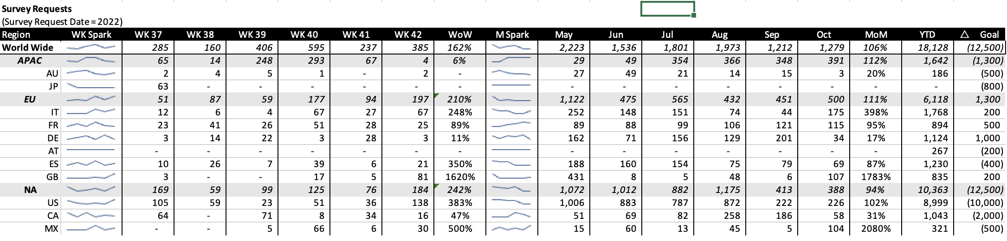
INTRODUCTION
WRITING A BETTER WBR
WHAT
WHAT METRIC AM I SURFACING
Metric does your presentation clearly describe what the view is looking at

Slide 10
INTRODUCTION
WRITING A BETTER WBR
HOW
HOW DID WE DO
Trend does the data give the view the ability to discern trends (if applicable)

Slide 11
INTRODUCTION
WRITING A BETTER WBR
WHY
WHY DOES IT MATTER?
Self Explanatory is the data showing the viewer enough information to understand if they should be concerned or not

Slide 12
INTRODUCTION
WRITING A BETTER WBR
WHY
WHY SHOULD THE READER CARE?
Commentary
----------------------------------------------------------------------------------
[NA] We completed 182 survey requests, +242% WoW and are tracking at 60% to OP2/ 75% to Q4G.
The increase was driven by the onboarding of Everest, Inc. with an additional 74 surveys.
We expect the survey request trend to continue in the US as the Host has 3K locations to be surveyed in the next 5 weeks, brining us above Q4G.
← BRIEF summary
← BRIEF Explanation
BRIEF PTG
(if applicable)
Commentary should add context /color to the data in the table. Note any highlights and lowlights that are driving the data.

Slide 13
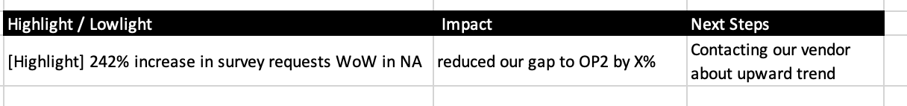
INTRODUCTION
WRITING A BETTER WBR
Commentary (only where needed)
---------------------------------------------------------------------------------------------------------------------
[NA] We completed 182 survey requests, +242% WoW and are tracking at 60% to OP2/ 75% to Q4G.
The increase was driven by the onboarding of Everest, Inc. with an additional 74 surveys.
We expect the survey request trend to continue in the US as the Host has 3K locations to be surveyed in the next 5 weeks, brining us above Q4G.

